Slide 1
𝐹𝒶𝓇𝒶`𝟥 Overview
DISCOVER THE FUTURE OF EGYPTIAN STREETWEAR
Meet 𝐹𝒶𝓇𝒶`𝟥, your digital gateway to authentic Egyptian streetwear fashion! This sleek online shopping platform marries cutting-edge web wizardry with the vibrant flair of local designs, ensuring your shopping spree is as smooth and stylish as your new threads.
Browse curated streetwear collections
Create accounts and manage profiles
Add items to a shopping cart
Complete purchases securely
View their order history

Slide 2
Problem Statement
The EgyptIAN FASHION MARKET LACKS DEDICATED ONLINE PLATFORMS FOR LOCAL STREETWEAR BRANDS THAT PROVIDE:
MODERN, USER-FRIENDLY SHOPPING EXPERIENCES
INTEGRATION OF EGYPTIAN CULTURAL AESTHETICS WITH CONTEMPORARY DESIGN
COMPLETE E-COMMERCE FUNCTIONALITY (USER ACCOUNTS, CART, CHECKOUT)
RESPONSIVE DESIGN FOR MOBILE AND DESKTOP USERS
INTERACTIVE PRODUCT SHOWCASES WITH ENGAGING ANIMATIONS
MARKET AND RELATED COMPANIES

Slide 3


Dec 29, 2025
Methodology Overview
Frontend Development: Methodology Used

Slide 4
Frontend Development
Enhancing user interaction and experience
HTML5 Structure
CSS3 Features & JAVASCRIPT
HTML5 provides a semantic structure that enhances accessibility and SEO, allowing for better content organization and improved search engine visibility, ensuring a richer user experience.
Utilizing CSS3 modern features like Flexbox and Grid enables responsive layouts, while CSS Variables facilitate easy theme management, including support for dark mode to enhance user comfort and DOM manipulation,regular exp.

Slide 5
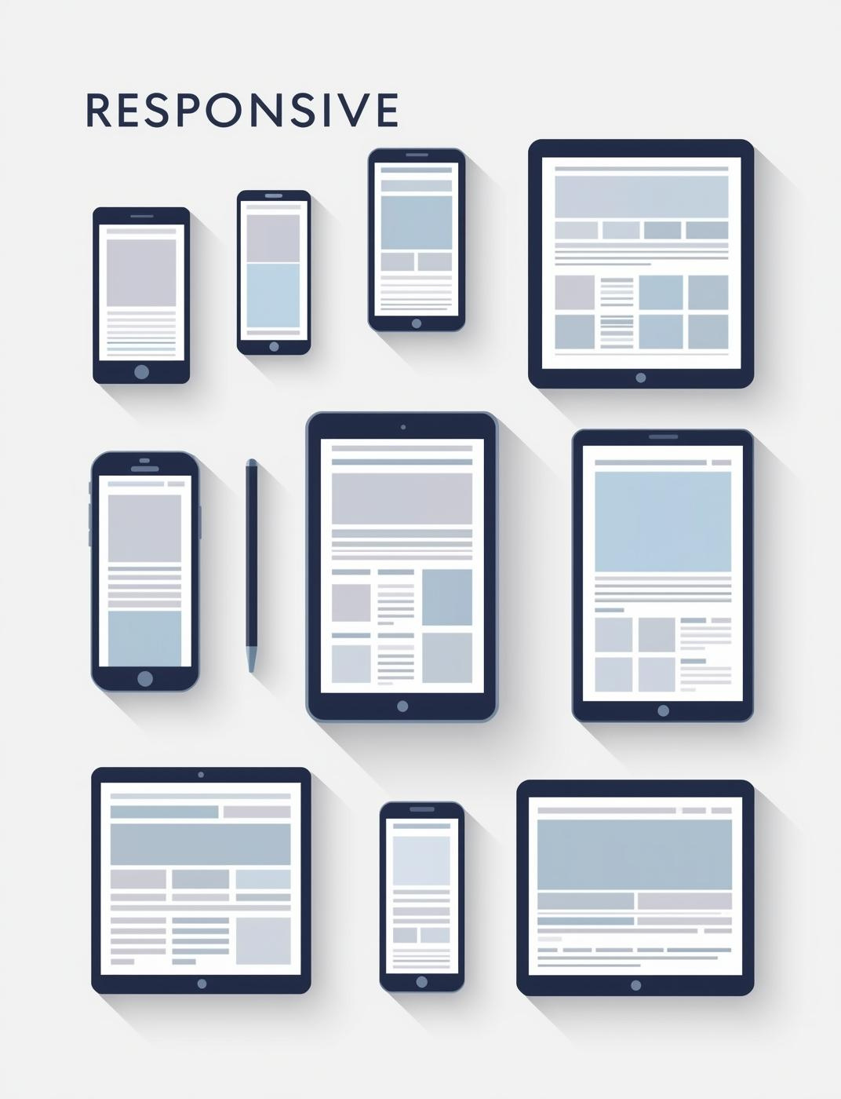
Responsive Design
A mobile-first approach ensures seamless user experiences across devices by prioritizing features and layout for smaller screens.

Slide 6
Backend Integration
Exploring the essential architecture methods
Flask API
LocalStorage Fallback
Flask provides a lightweight backend framework, enabling easy integration for developing RESTful APIs, ensuring quick responses for user authentication and cart management functionalities.
Implementing localStorage offers a reliable backup solution, allowing seamless cart management and user session persistence even when the backend service is temporarily unresponsive.

Slide 7

JSON Data Handling
Effective JSON data handling ensures smooth product information retrieval, enhancing user experience and optimizing application performance.

Slide 8
User Experience
Enhancing interaction through design elements
Parallax Effects
Smooth Transitions
Parallax scrolling creates depth by allowing background images to move slower than foreground content, resulting in a dynamic experience that engages users and enhances storytelling.
Implementing smooth transitions and micro-interactions enhances usability, providing users with instant feedback and guiding them effortlessly through the application, thereby increasing overall satisfaction and engagement.

Slide 9

Progressive Enhancement
A progressive enhancement approach ensures users benefit from a robust experience, regardless of their browser capabilities or network conditions.

Slide 10

System Features
Key components for your e-commerce platform
User Authentication
Order History
Product Management
Implement a secure user authentication system, allowing easy registration with validation, seamless login/logout functionality, and comprehensive user profile management for enhanced user experience.
Track purchase history effortlessly, providing users with access to their previous orders, delivery statuses, and allowing them to reorder items conveniently.
Manage products effectively with collection-based organization, dynamic galleries, and detailed product modals, ensuring customers can easily find and learn about the items they desire.

Slide 11
UI/UX Design
Enhancing user experience and interaction
Parallax Section
Shopping Cart
Checkout System
The floating parallax hero section creates an engaging first impression, drawing users into the site with dynamic visuals and smooth transitions that enhance navigation and exploration.
Users can easily manage their shopping cart by adding or removing items, adjusting quantities, and witnessing real-time total calculations for a seamless purchasing experience.
The checkout system supports multiple payment methods, ensuring secure transactions, while providing order confirmation and maintaining an organized order history for user convenience.

Slide 12
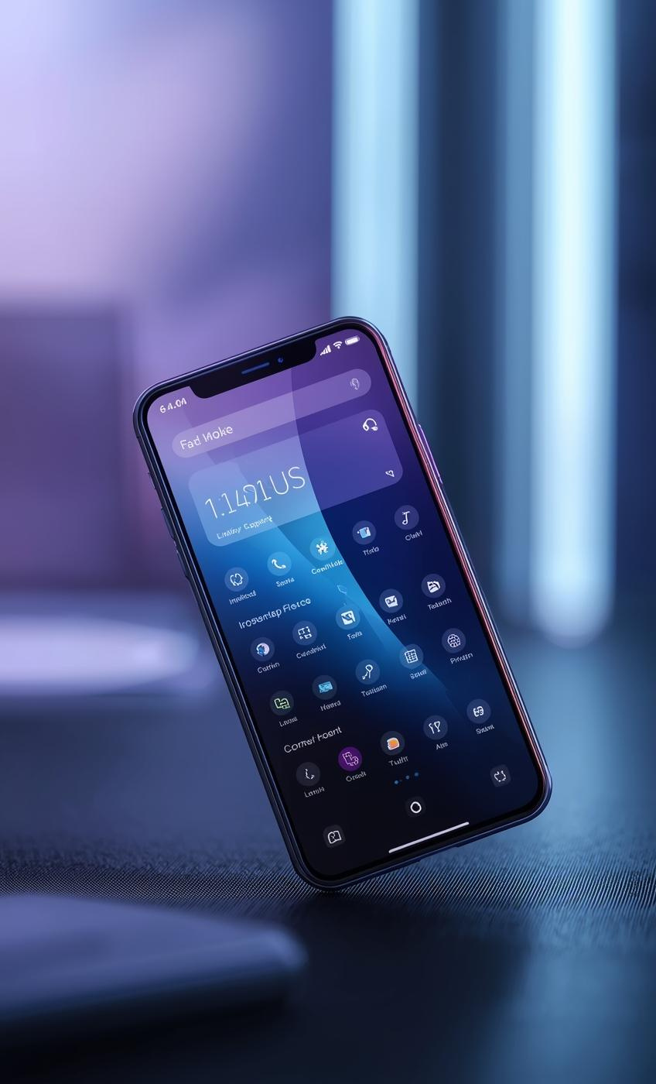
More Features
FLOATING ANIMATIONS
Create a more engaging user experience visually.
FORM VALIDATION
Ensure user inputs are accurate and reliable.
MOBILE SIDEBAR NAVIGATION
Effortless access to content on mobile devices.

Slide 13
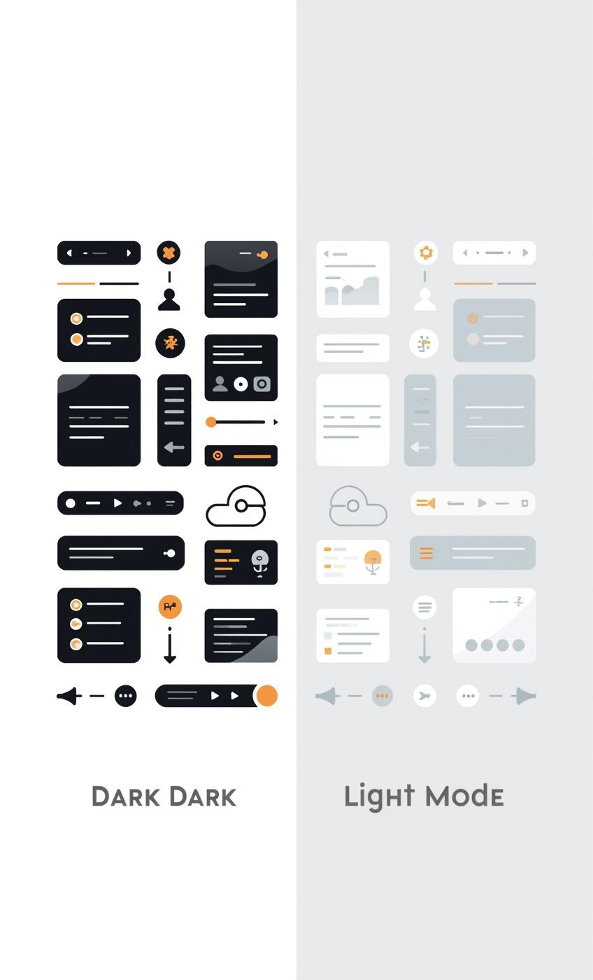
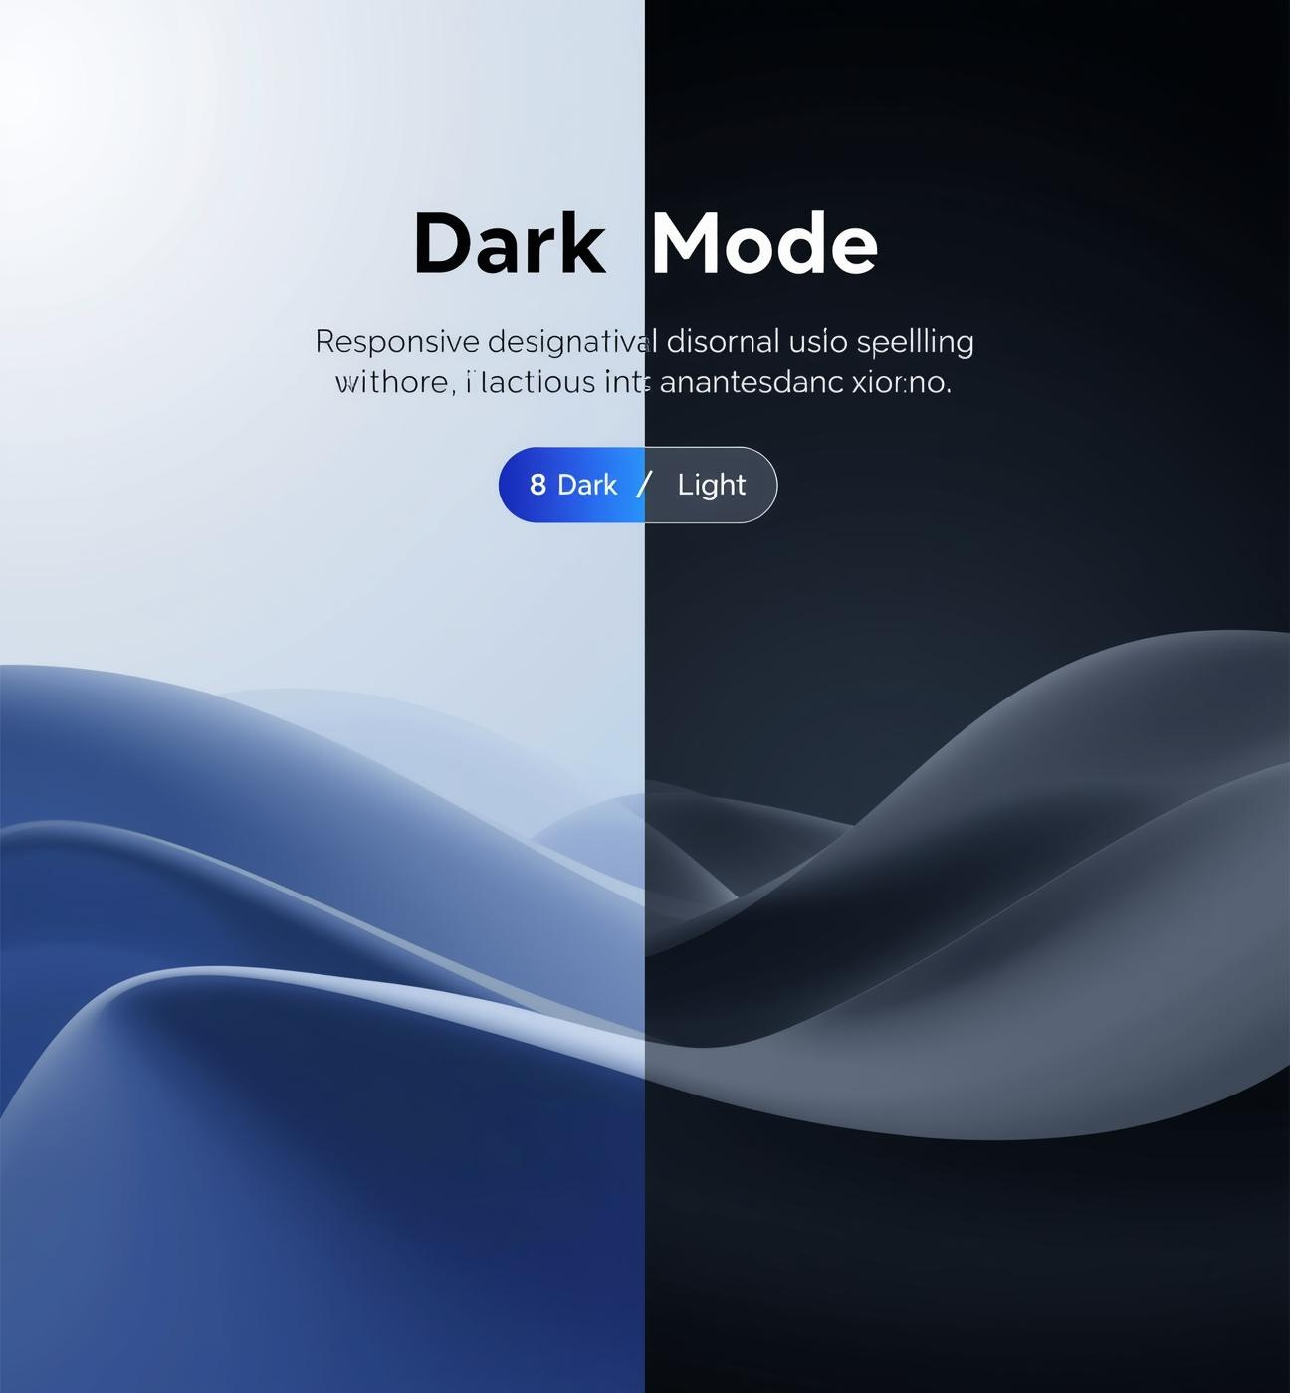

Slide 14
How the website works

Slide 15
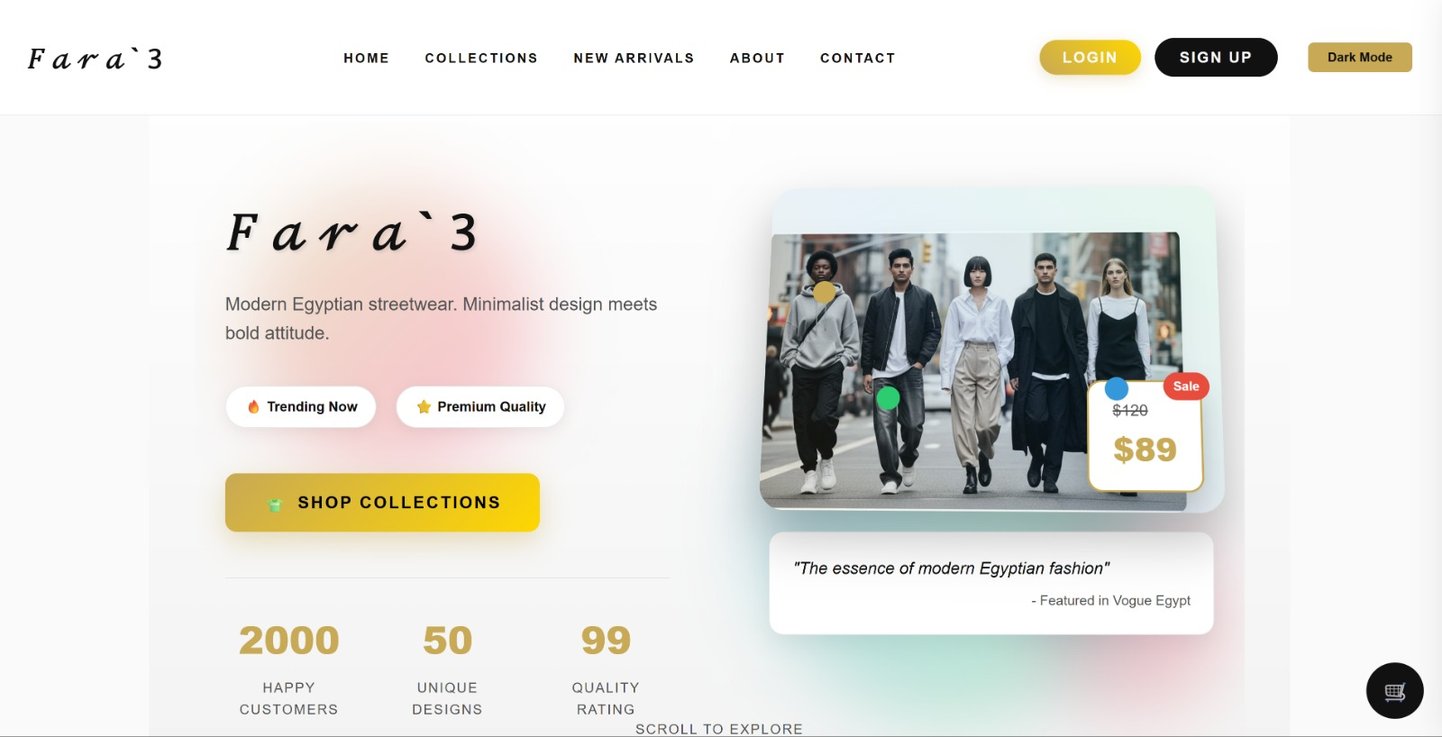

Slide 16
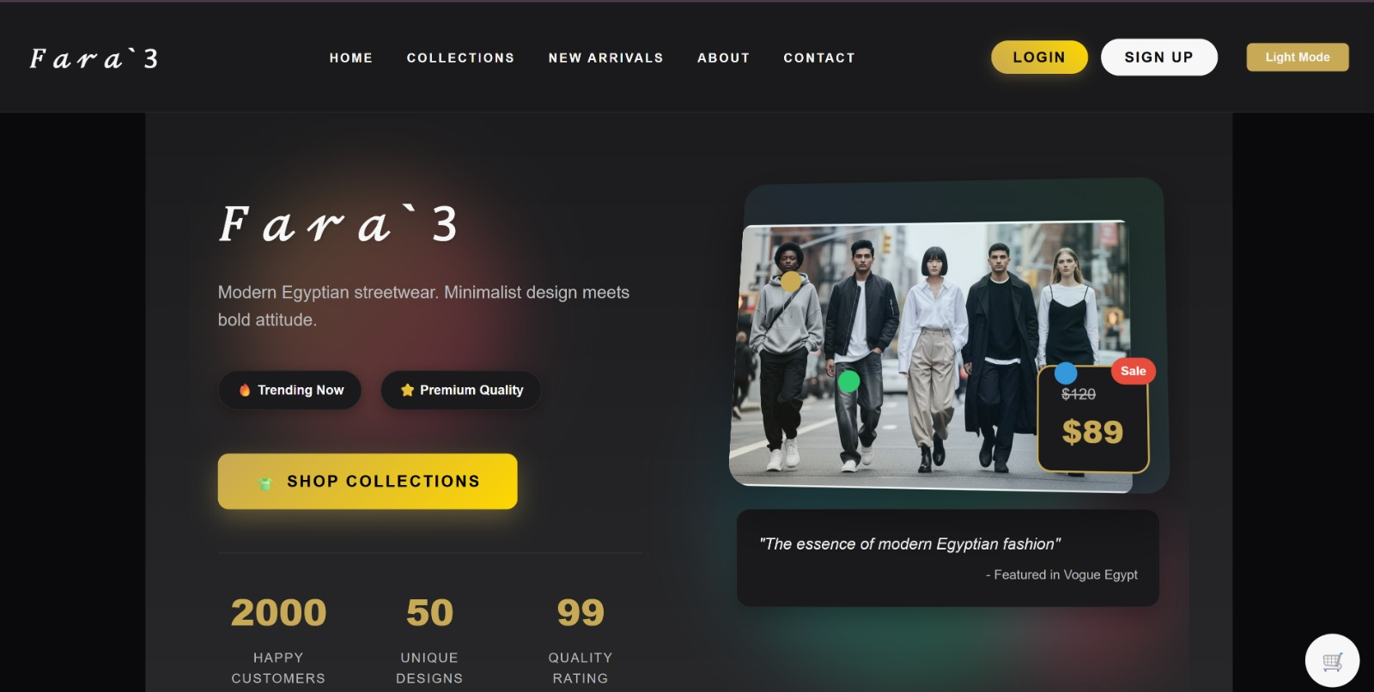

Slide 17
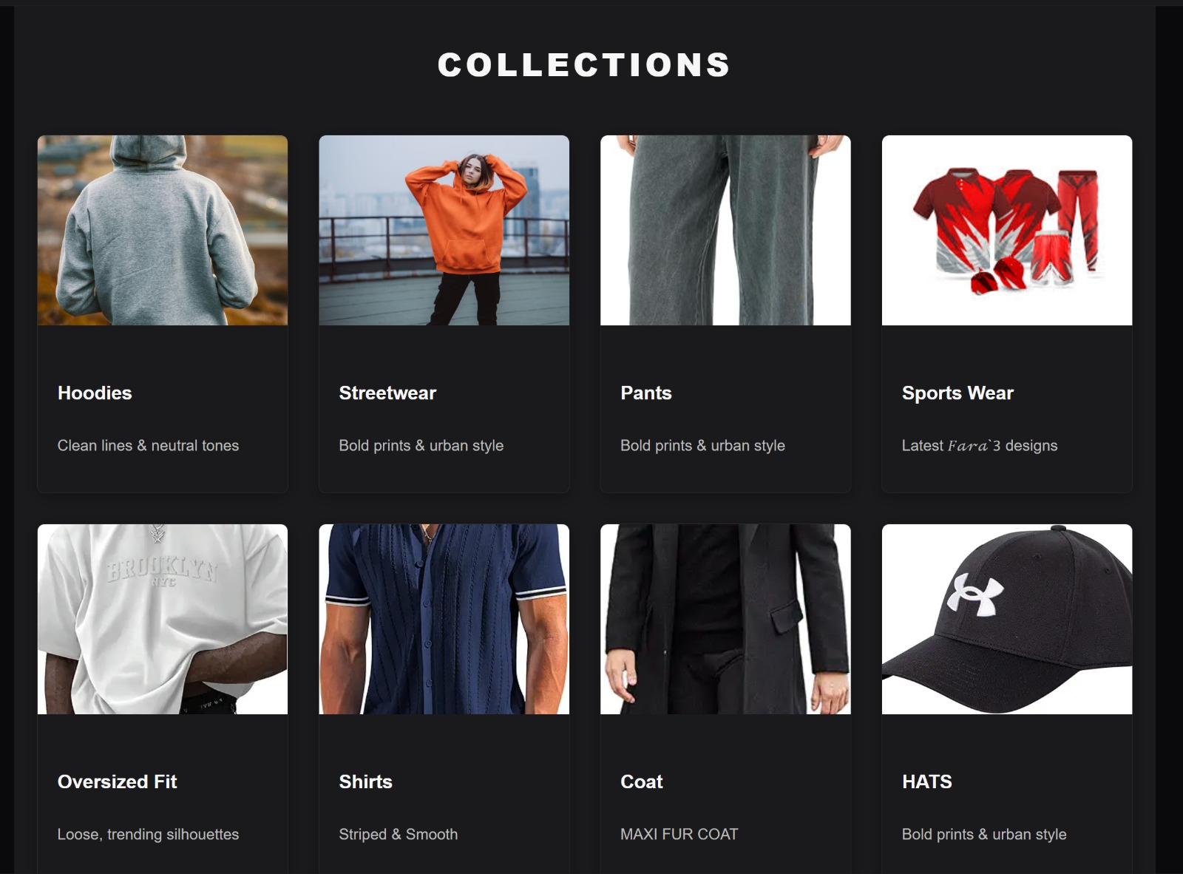

Slide 18
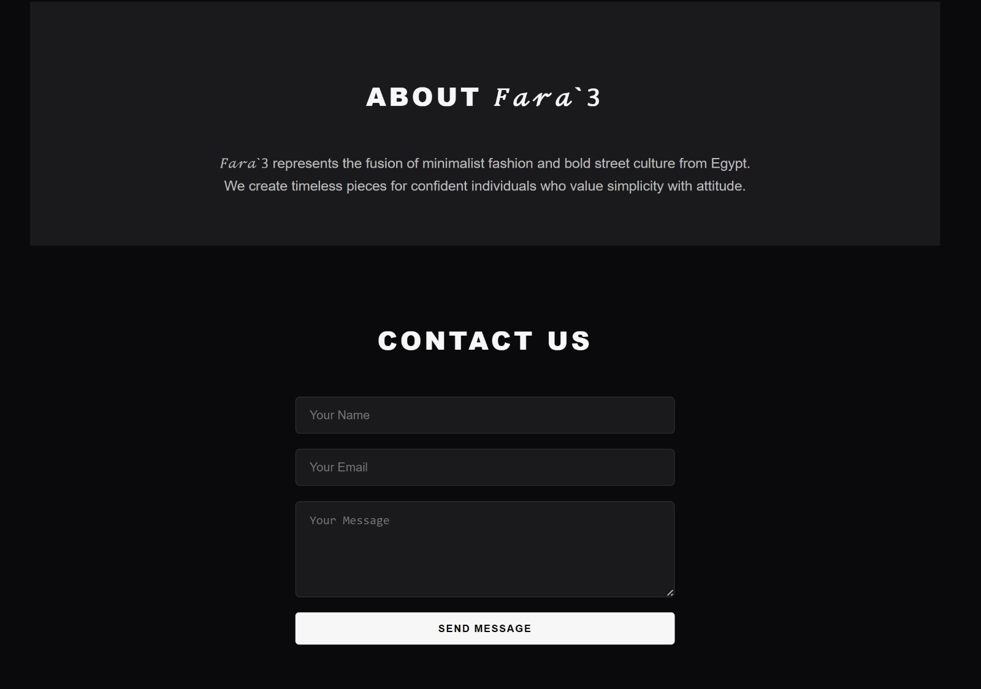

Slide 19
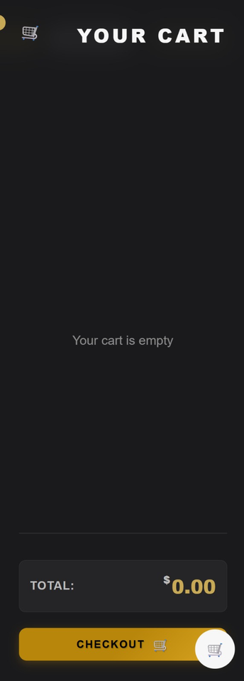
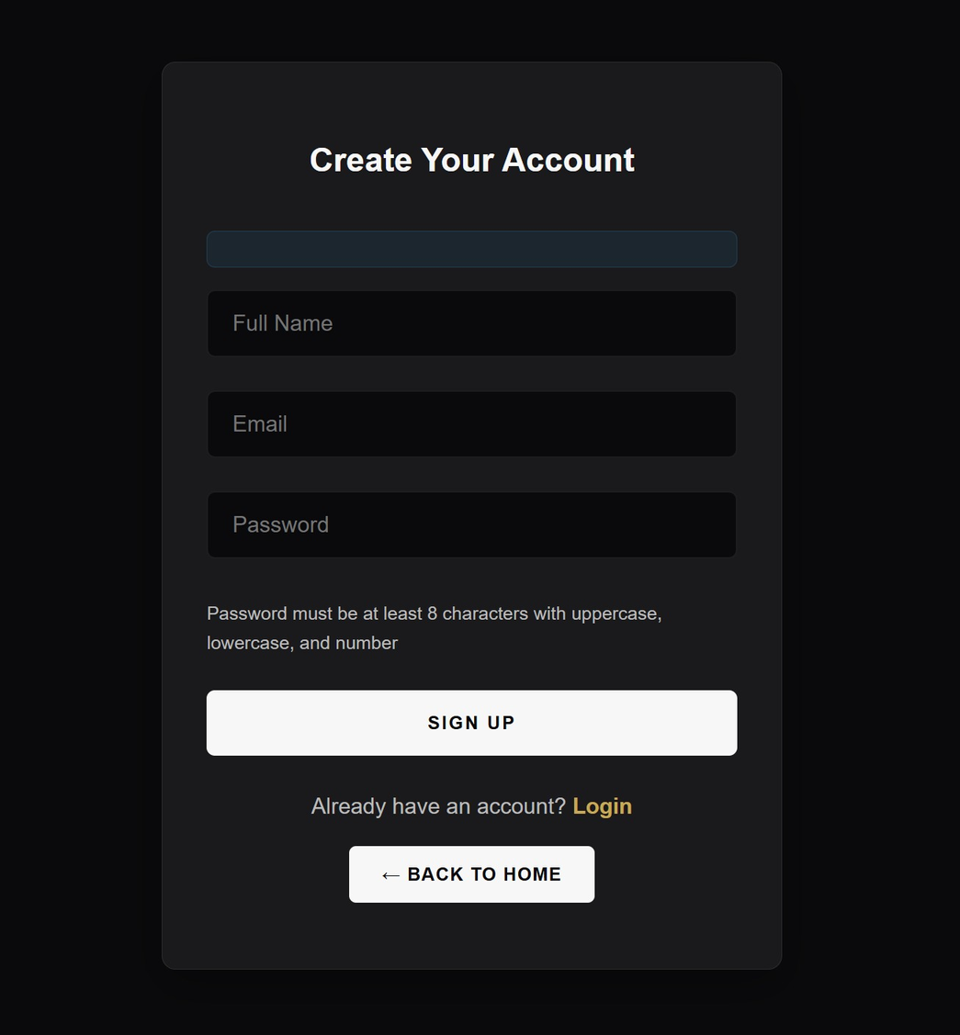
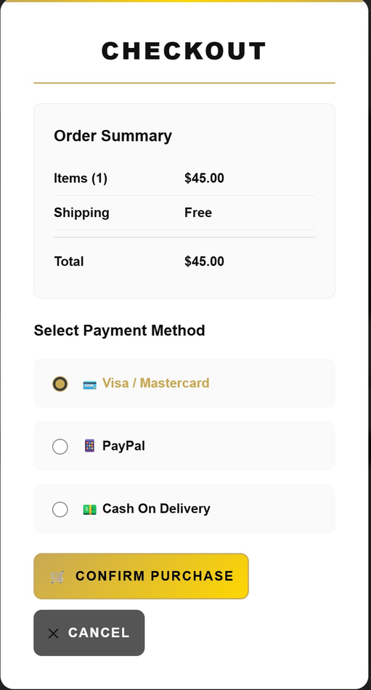

Slide 20
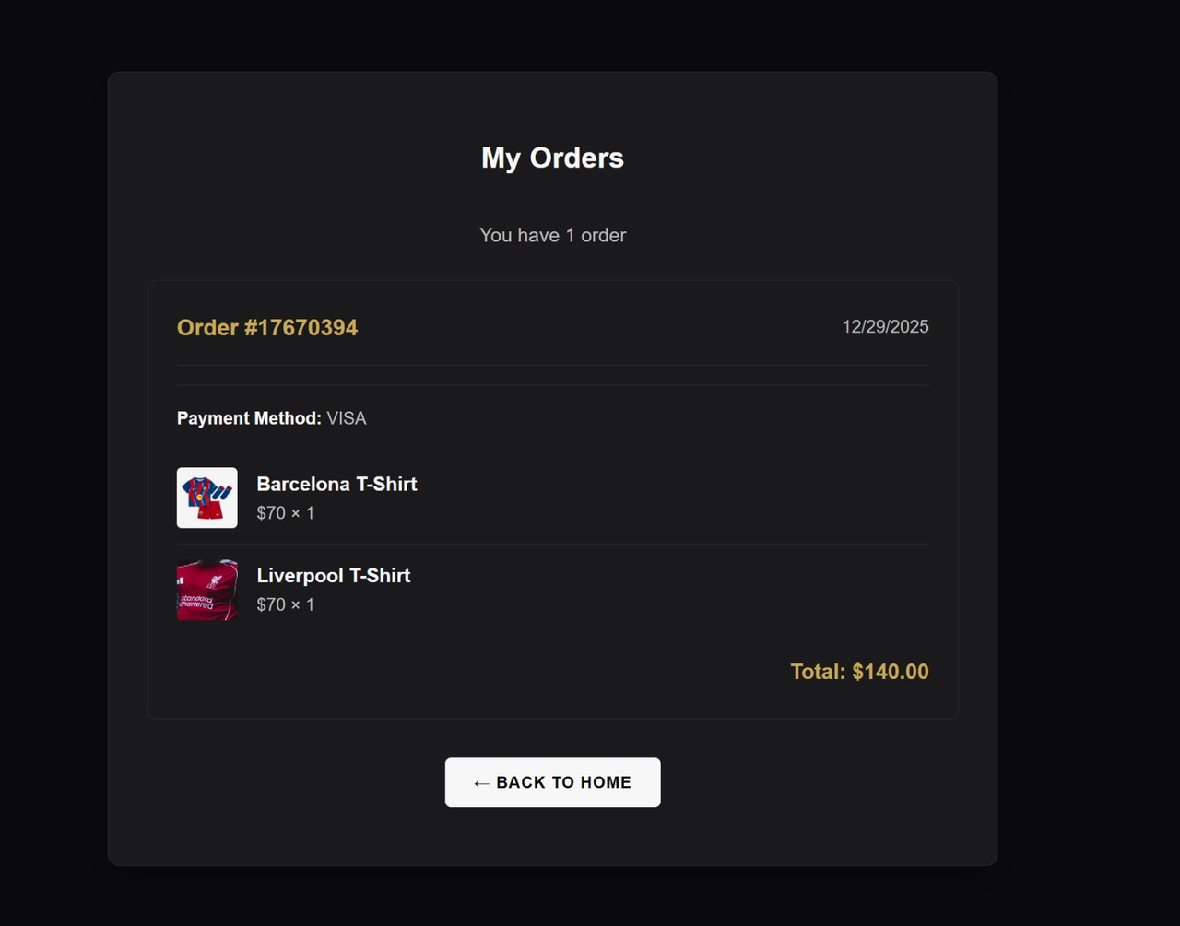
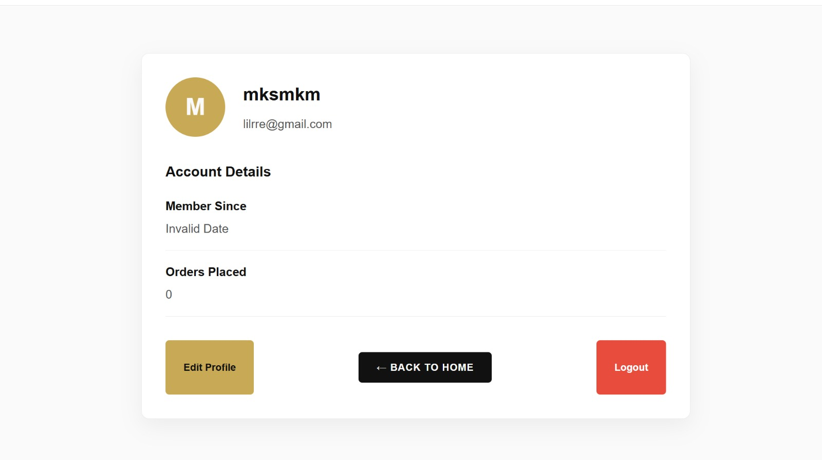

Slide 21
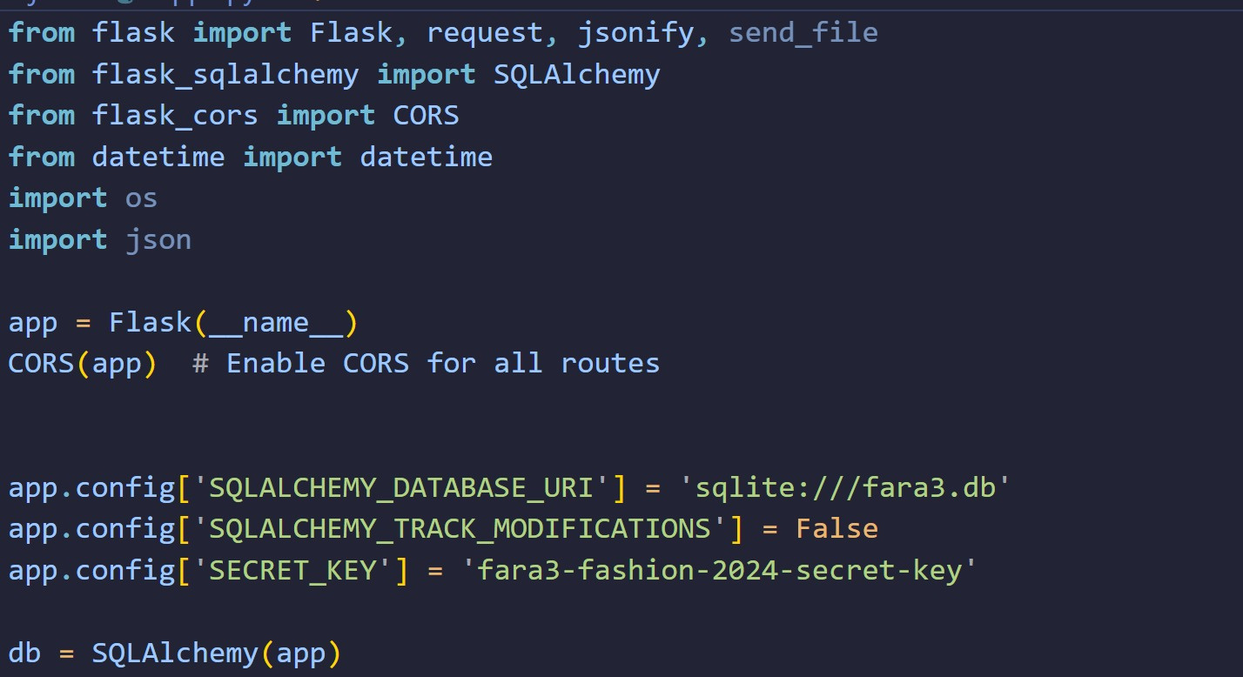

Slide 22
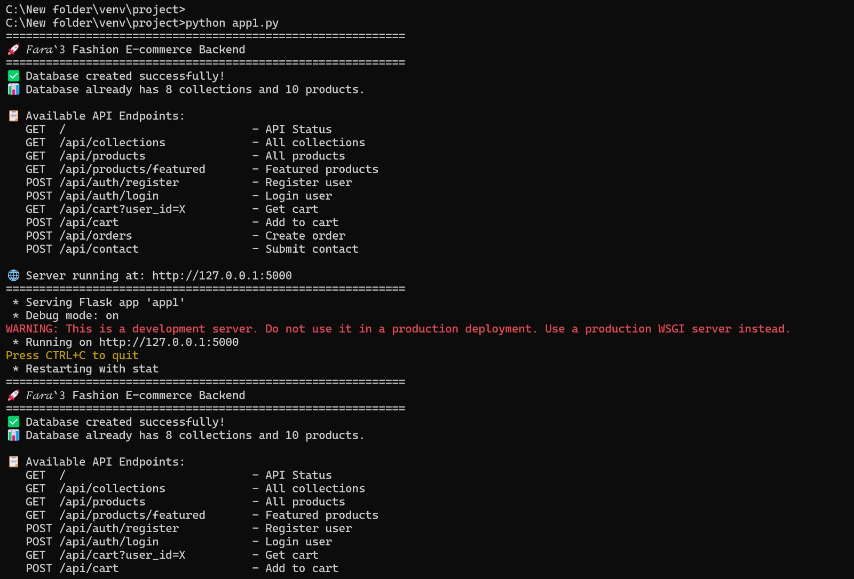

Slide 23
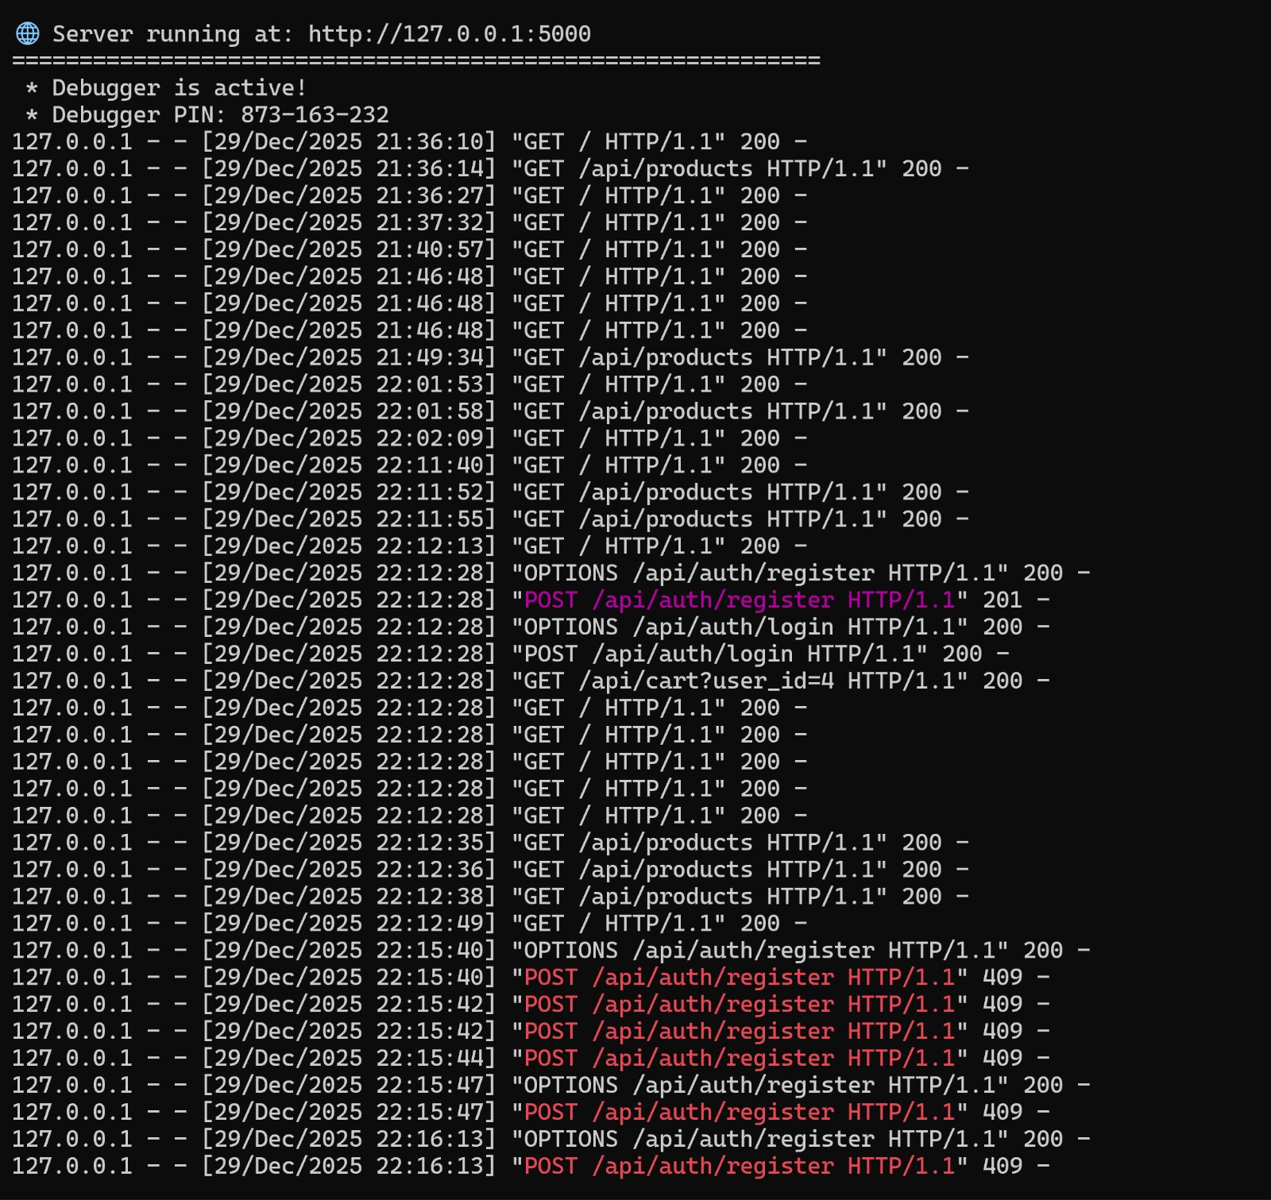

Slide 24
THE END

